Slide 1
COMPUTER ORGANISATION AND ARCHITECTURE
TOPICS: 1) RIPPLE CARRY ADDER
2) CARRY LOOK AHEAD ADDER
3) BOOTH MULTIPLICATION ALGORITHM

Slide 2
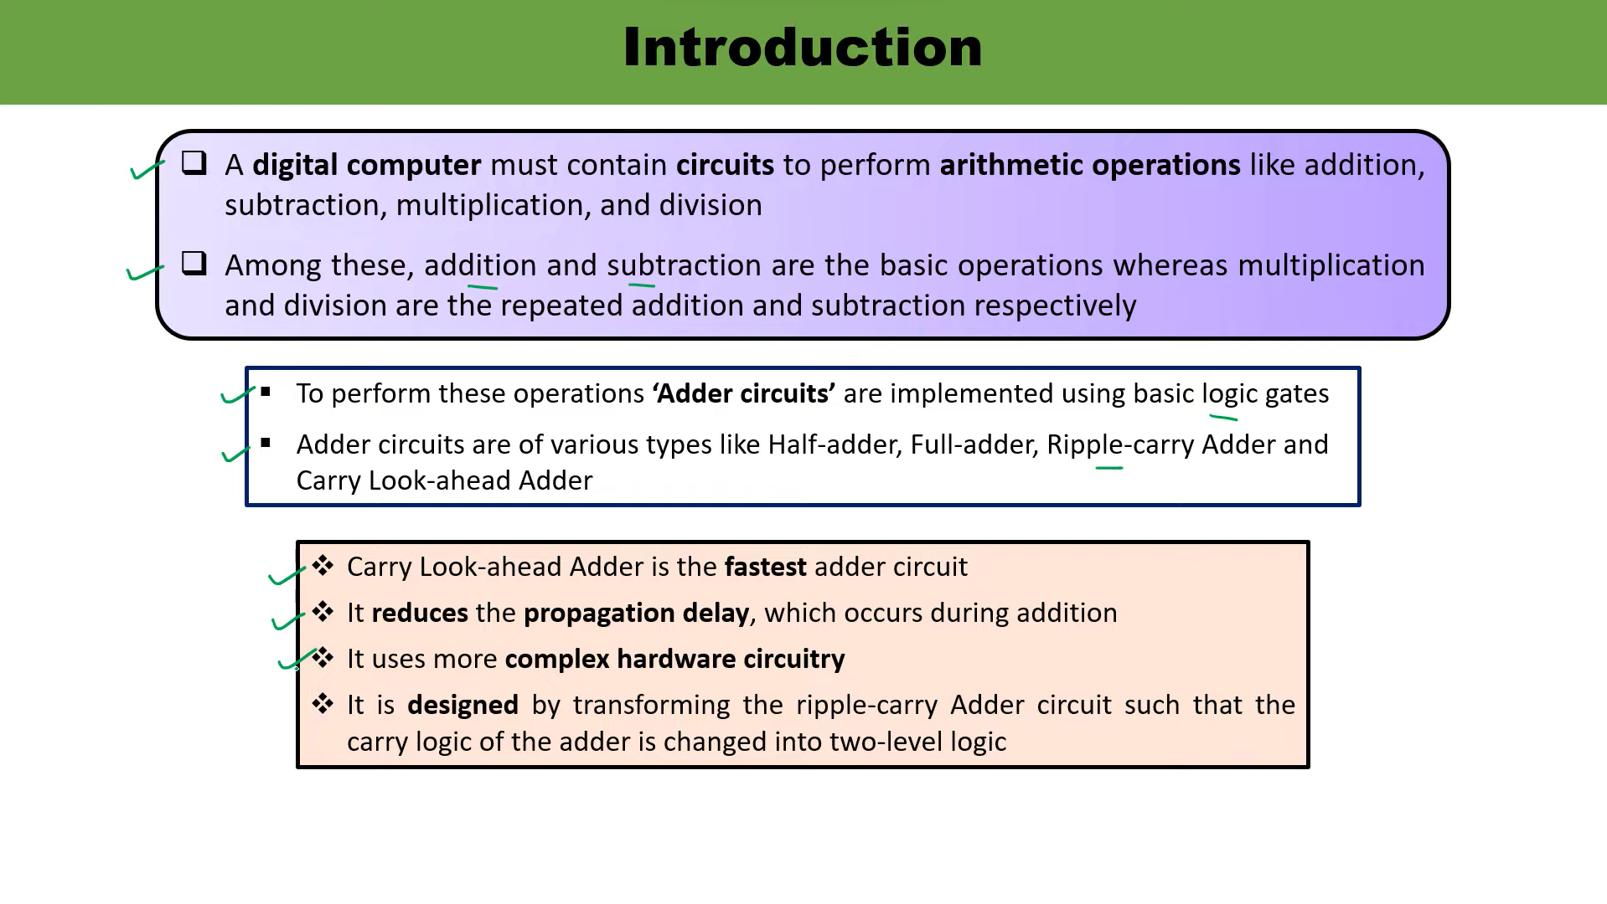

Slide 3
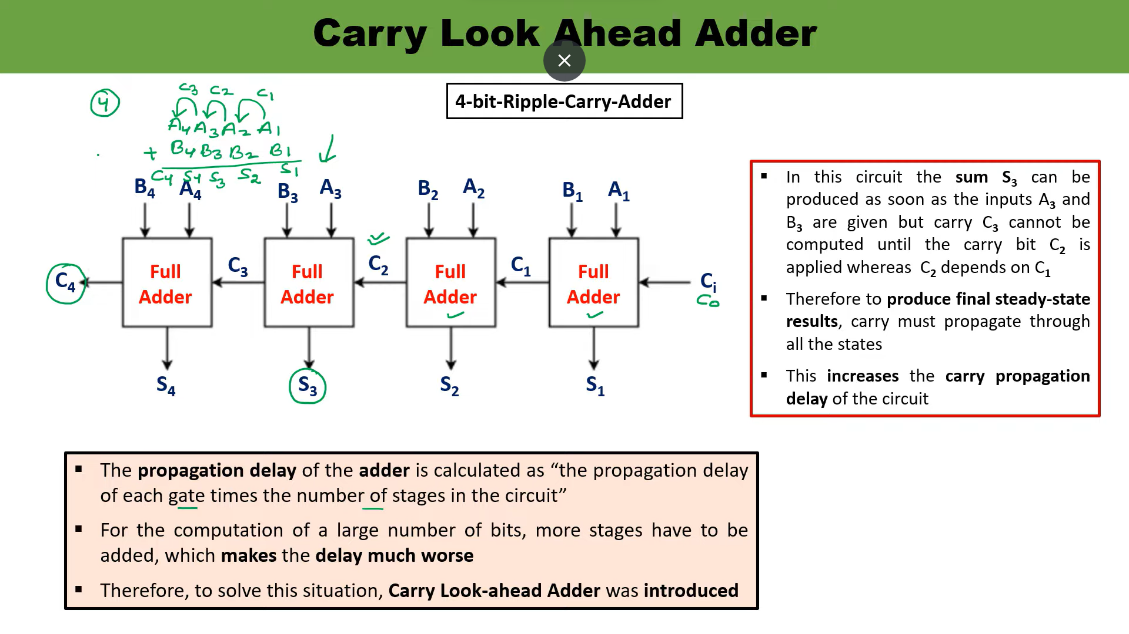

Slide 4
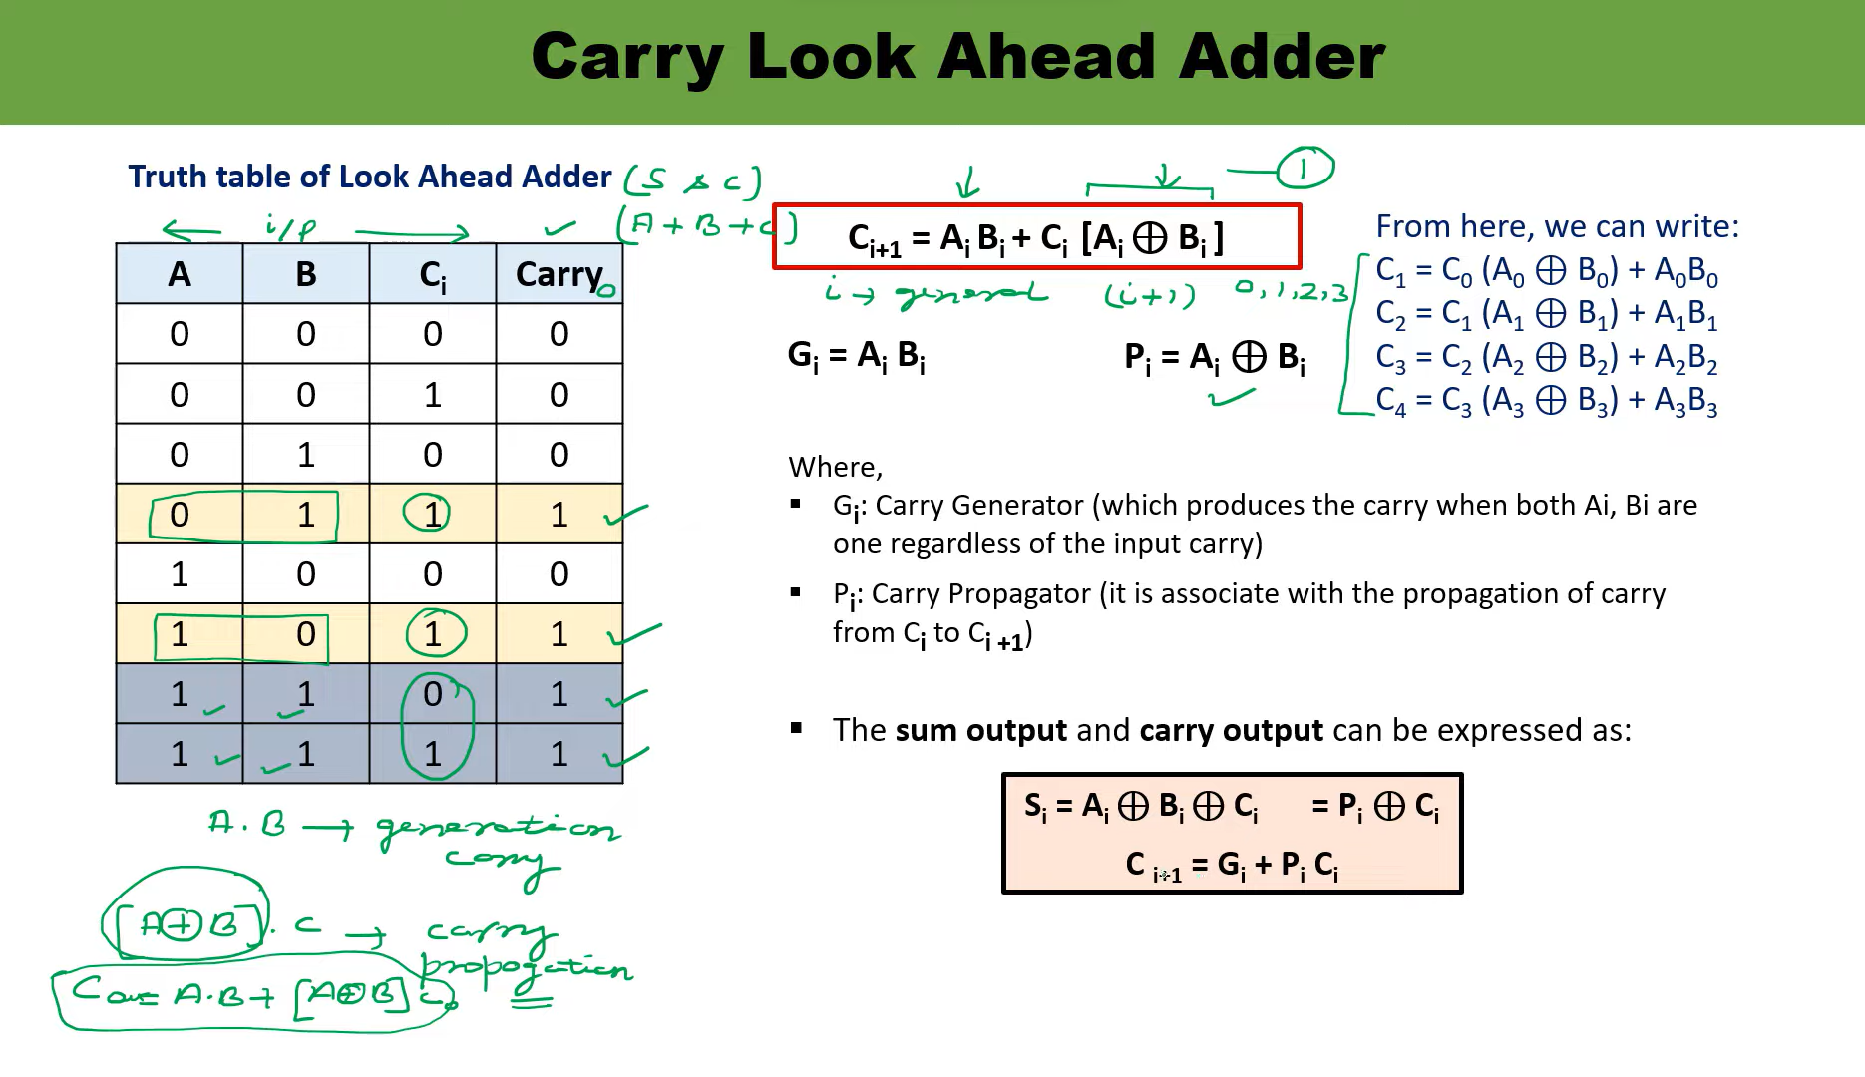

Slide 5
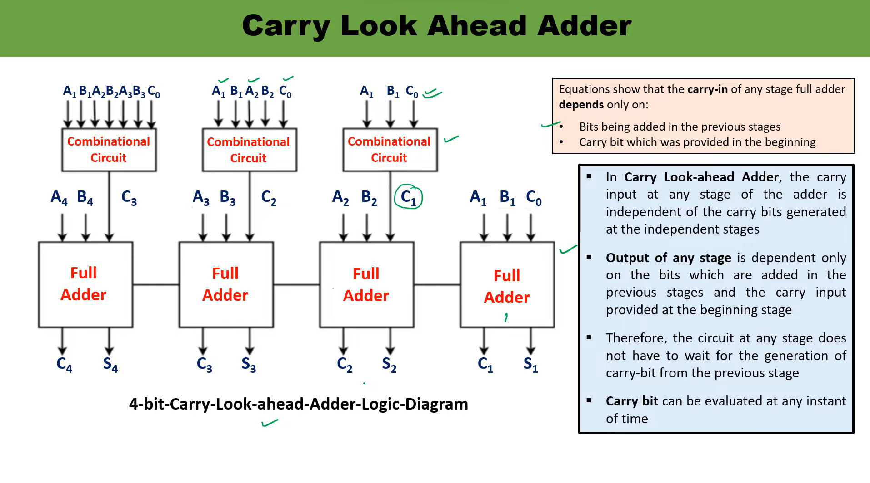

Slide 6
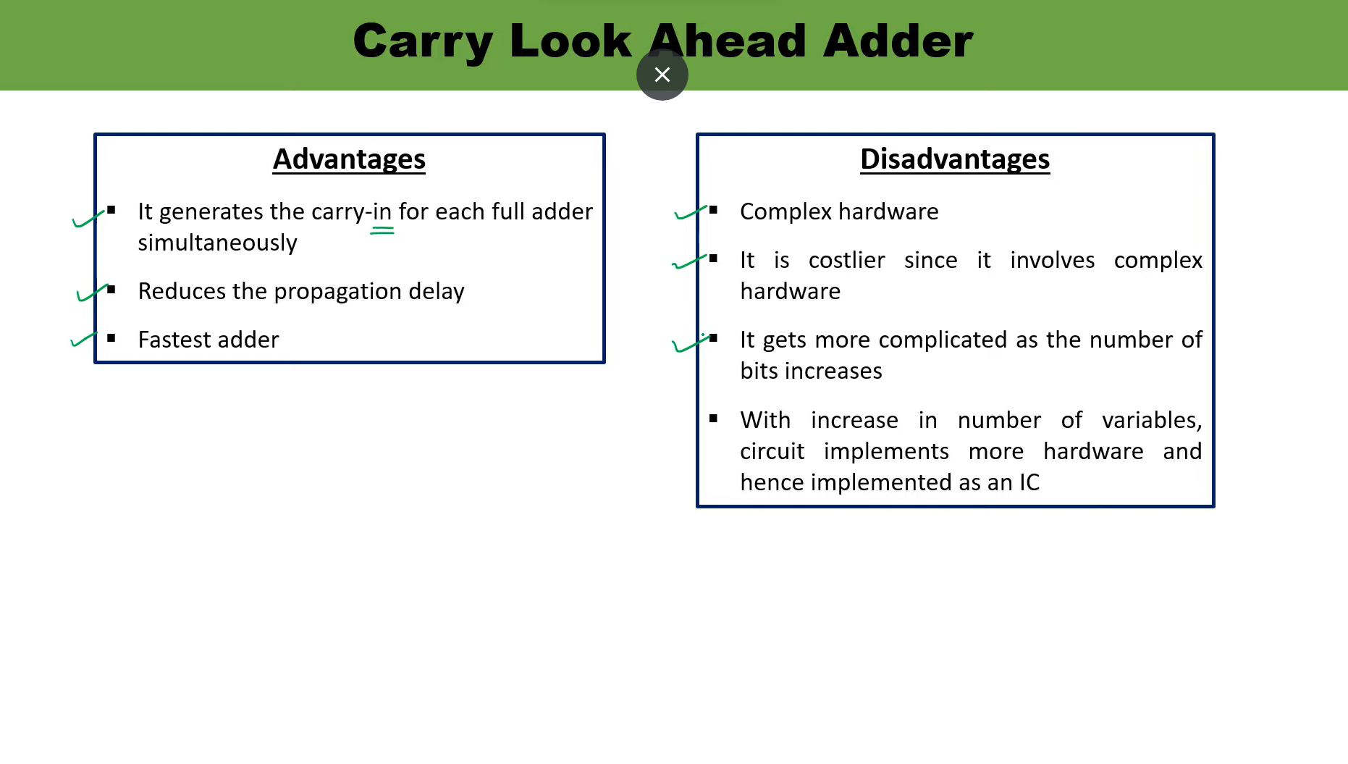

Slide 7
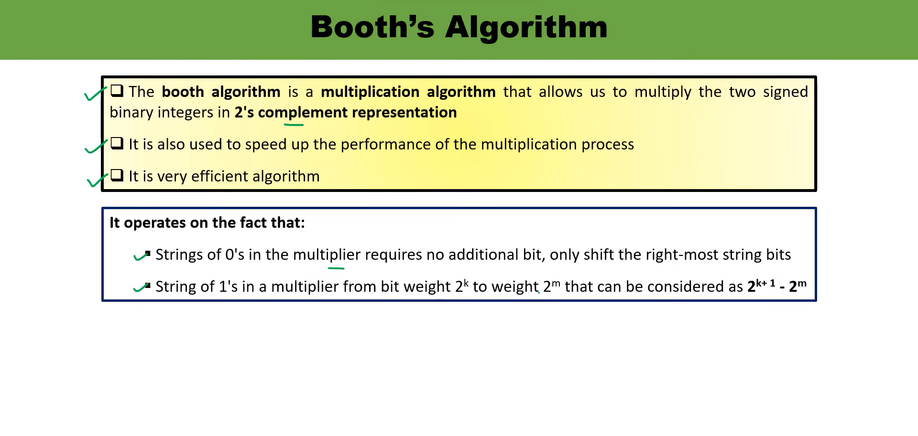

Slide 8
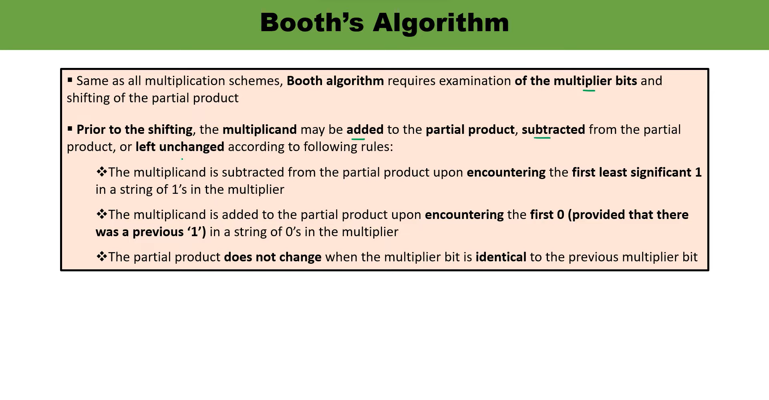

Slide 9
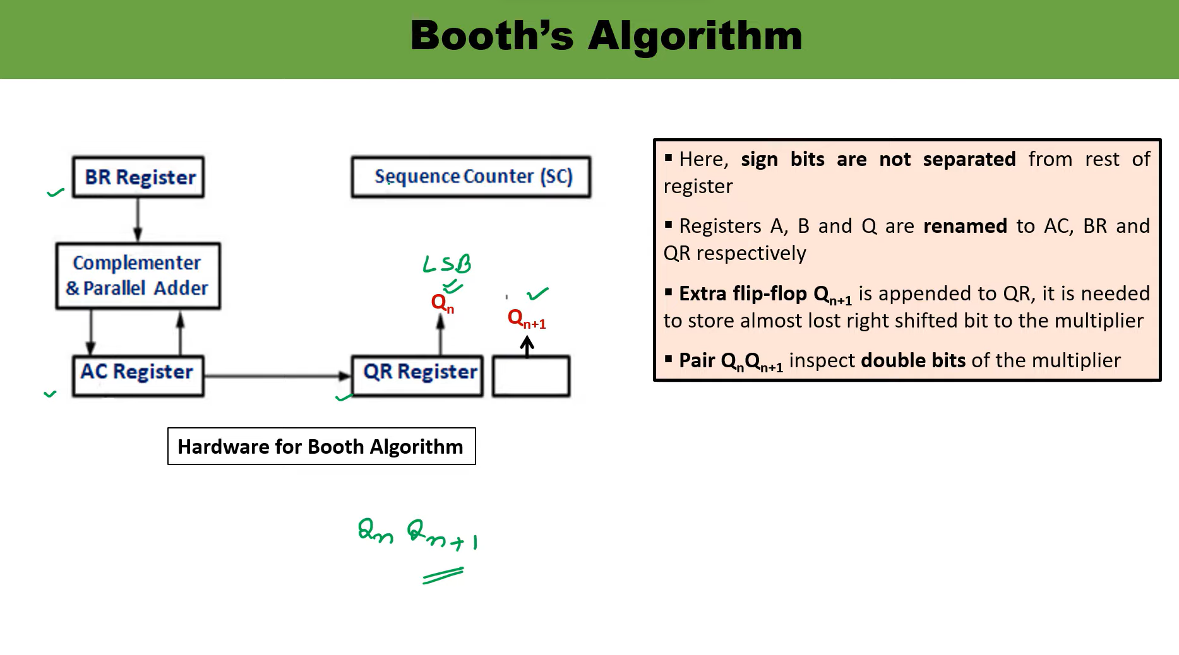

Slide 10
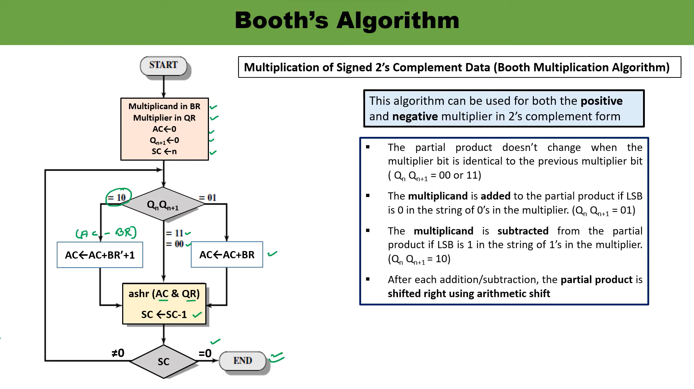

Slide 11
